Slide 1
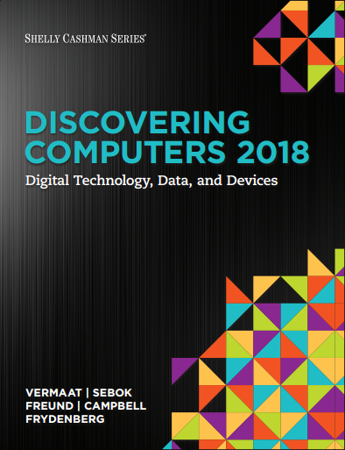

DISCOVERING COMPUTERS 2018 Digital Technology, Data, and Devices
Module 9
Operating Systems: Managing Coordinating, and Monitoring Resources
Copyright © 2018 Cengage Learning®. May not be scanned, copied or duplicated, or posted to a publicly accessible website, in whole or in part.

Slide 2
Objectives Overview (1 of 2)
Explain the purpose of an operating system
Describe the start-up process and shutdown options on computers and mobile devices
Explain how an operating system provides a user interface, manages programs, manages memory, and coordinates tasks
Describe how an operating system enables users to configure devices, establish an Internet connection, and monitor performance

Slide 3
Objectives Overview (2 of 2)
Identify file management and other tools included with an operating system, along with ways to update operating system software
Explain how an operating system enables users to control a network or administer security
Summarize the features of several desktop operating systems
Briefly describe various server operating systems
Summarize the features and uses of several mobile operating systems

Slide 4
Operating Systems (1 of 3)
Start and shut down a computer or mobile device
Provide a user interface
Manage programs
Manage memory
Coordinate tasks
Configure devices
Monitor performance
Establish an Internet connection

Slide 5
Operating Systems (2 of 3)
Provide file management and other device or media-related tasks
Updating operating system software
Control a network
Administer security

Slide 6
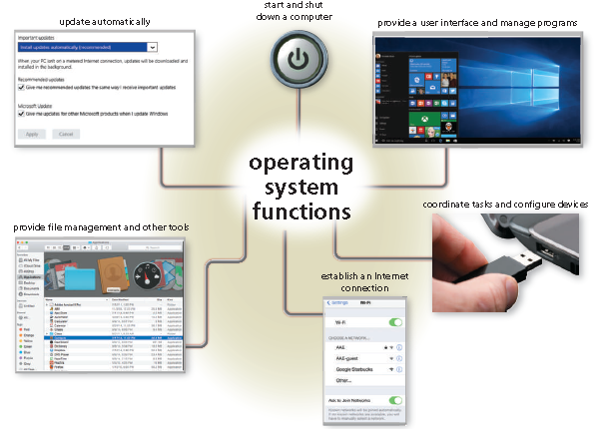
Operating Systems (3 of 3)
Figure 9-1 Most operating systems perform similar functions, some of which are illustrated above.

Slide 7
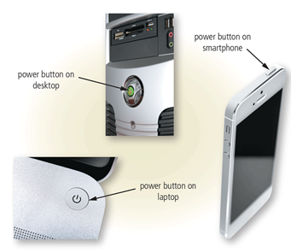
Operating System Functions (1 of 19)
Starting Computers and Mobile Devices
If a computer or mobile device is off, you press a power button to turn it on
Figure 9-2 Examples of power buttons on computers and mobile devices.

Slide 8
Operating System Functions (2 of 19)
An operating system includes various power options
Sleep mode saves any open documents and running programs or apps to RAM, turns off all unneeded functions, and then places the computer in a low-power state
Hibernate mode saves any open documents and running programs or apps to an internal hard drive before removing power from the computer or device

Slide 9
Operating System Functions (3 of 19)
A user interface (UI) controls how you enter data and instructions and how information is displayed on the screen
With a graphical user interface (GUI), you interact with menus and visual images

Slide 10
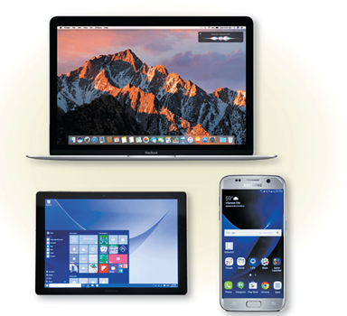
Operating System Functions (4 of 19)
Figure 9-3 Examples of operating system graphical user interfaces on some computers and mobile devices

Slide 11
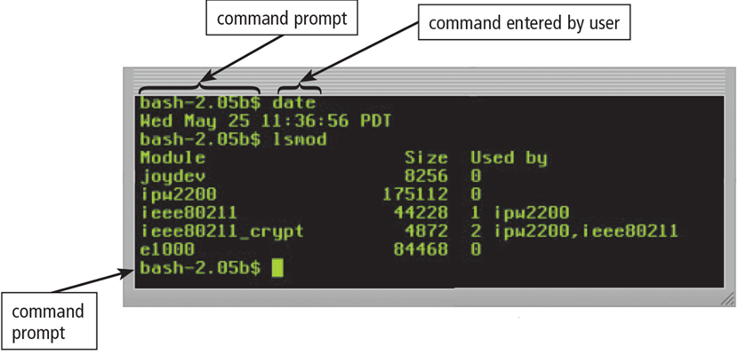
Operating System Functions (5 of 19)
In a command-line interface, a user types commands represented by short keywords or abbreviations or presses special keys on the keyboard to enter data and instructions
Figure 9-4 A command-line interface requires you to enter exact spelling, form, and punctuation

Slide 12
Operating System Functions (6 of 19)
How an operating system handles programs directly affects your productivity
Single tasking and multitasking
Foreground and background
Single user and multiuser

Slide 13
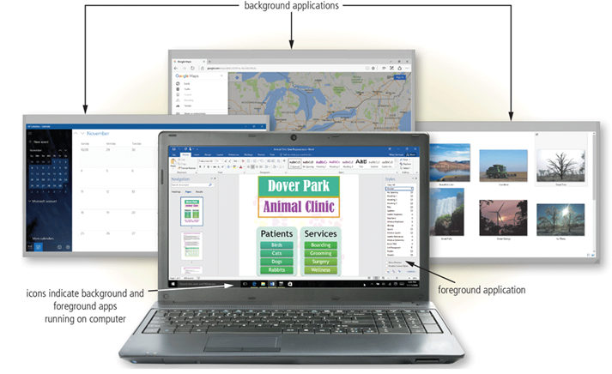
Operating System Functions (7 of 19)
Figure 9-5 The foreground application, Microsoft Word, is displayed on the screen. The other applications (Calendar, Google Maps in Edge, and File Explorer) are in the background

Slide 14
Operating System Functions (8 of 19)
Memory management optimizes the use of the computer or device’s internal memory
Virtual memory is a portion of a storage medium functioning as additional RAM

Slide 15
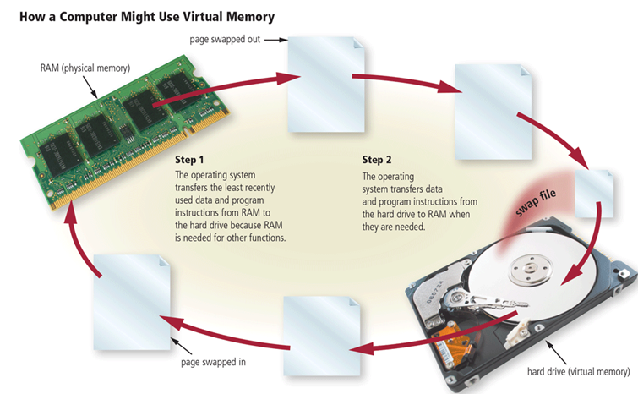
Operating System Functions (9 of 19)
Figure 9-8 This figure shows how a computer might use virtual memory

Slide 16
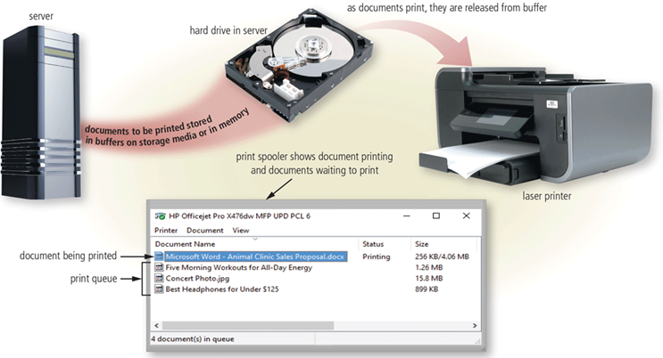
Operating System Functions (10 of 19)
The operating system determines the order in which tasks are processed
Figure 9-9 Spooling increases both processor and printer efficiency by placing documents to be printed in a buffer media before they are printed. This figure shows three documents in the queue with one document printing.

Slide 17
Operating System Functions (11 of 19)
A driver is a small program that tells the operating system how to communicate with a specific device
Plug and Play automatically configures new devices as you install or connect them

Slide 18
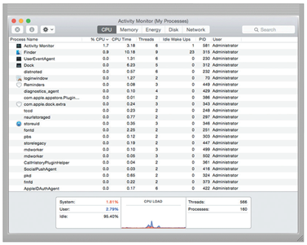
Operating System Functions (12 of 19)
A performance monitor is a program that assesses and reports information about various computer resources and devices
Figure 9-10 The Activity Monitor in this figure is tracking CPU (processor) usage.
Source: Apple Inc.

Slide 19
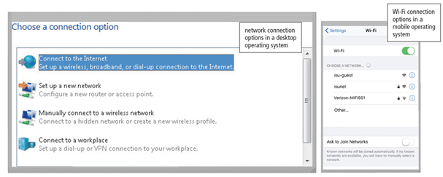
Operating System Functions (13 of 19)
Operating systems typically provide a means to establish Internet connections
Figure 9-11 Shown here are Internet connection options for desktop and mobile operating systems.

Slide 20
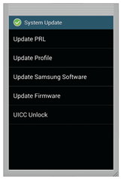
Operating System Functions (14 of 19)
Many programs, including operating systems, include an automatic update feature that regularly provides new features or corrections to the program
Figure 9-12 An operating system usually includes a means to download and install important updates.

Slide 21
Operating System Functions (15 of 19)
Operating systems often provide users with a variety of tools related to managing a computer, its devices, or its programs
File Manager
Search
Image Viewer
Uninstaller
Disk Cleanup
Disk Defragmenter

Slide 22
Operating System Functions (16 of 19)
Screen Saver
File Compression
PC Maintenance
Backup and Restore
Power Management

Slide 23
Operating System Functions (17 of 19)
Some operating systems are designed to work with a server on a network
These multiuser operating systems allow multiple users to share a printer, Internet access, files, and programs
A network administrator uses the server operating system to:
Add and remove users, computers, and other devices
Configure the network, install software and administer network security

Slide 24
Operating System Functions (18 of 19)
A user account enables a use to sign in to, or access resources on, a network or computer
A user name, or user ID, identifies a specific user
A password is a private combination of characters associated with the user name

Slide 25
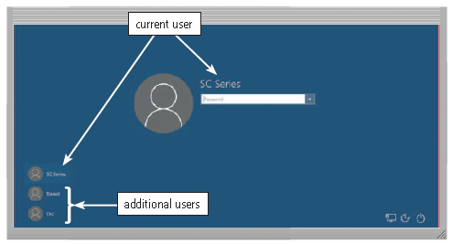
Operating System Functions (19 of 19)
Figure 9-13 Most multiuser operating systems allow each user to sign in, which is the process of entering a user name and a password into the computer. Single-user operating systems often use a password to lock an entire device or computer.

Slide 26
Types of Operating Systems
Table 9-2 Examples of Operating Systems by Category
Category | Name
Desktop | Windows macOS UNIX Linux Chrome OS
Server | Windows Server macOS Server UNIX Linux
Mobile | Google Android Apple iOS Windows 10 Mobile

Slide 27
Desktop Operating Systems (1 of 8)
A desktop operating system is a complete operating system that works on desktops, laptops, and some tablets
Windows
macOS
UNIX
Linux
Chrome OS

Slide 28
Desktop Operating Systems (2 of 8)
The latest versions of Windows offer these features
Uses tiles to access apps
Includes the desktop interface
Support for input via touch, mouse, and keyboard
Email app, calendar app, and browser (Edge) included
Photos, files, and settings you can sync with One-Drive
Enhanced security through an antivirus program, firewall, and automatic updates
Windows Store offers additional applications for purchase

Slide 29
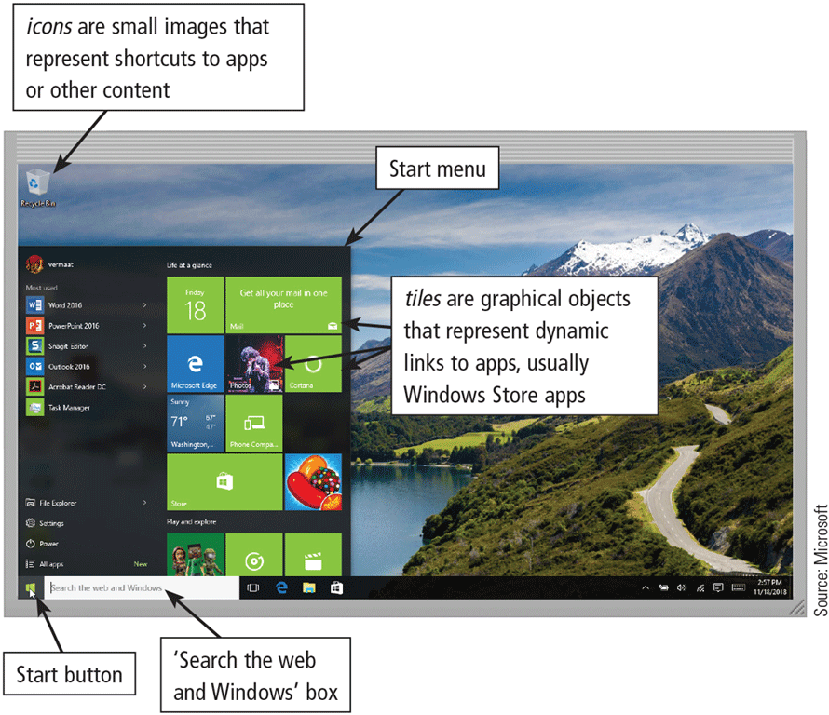
Desktop Operating Systems (3 of 8)

Slide 30
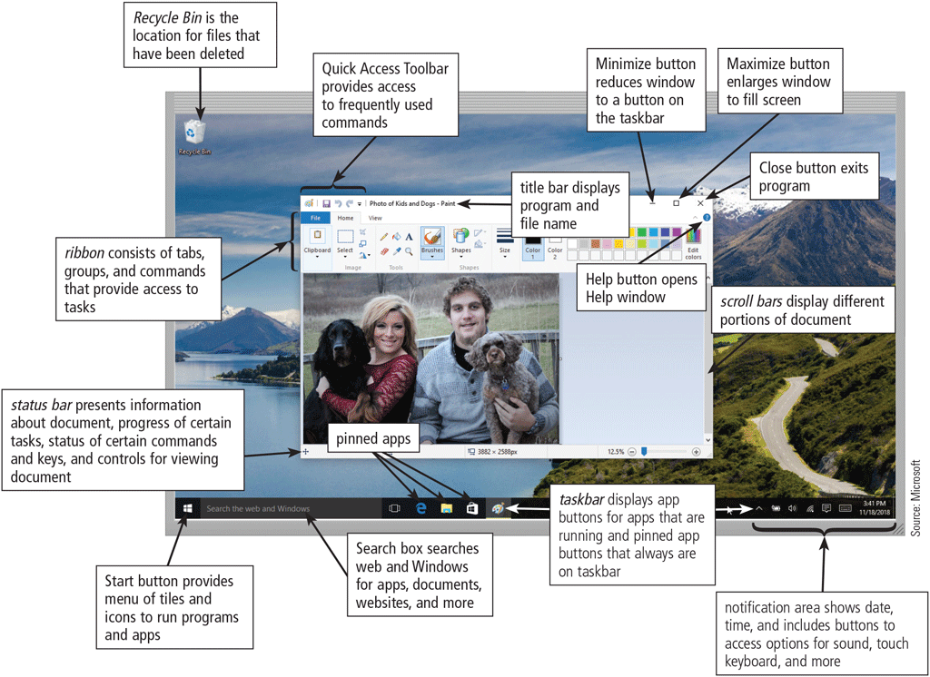
Desktop Operating Systems (4 of 8)

Slide 31
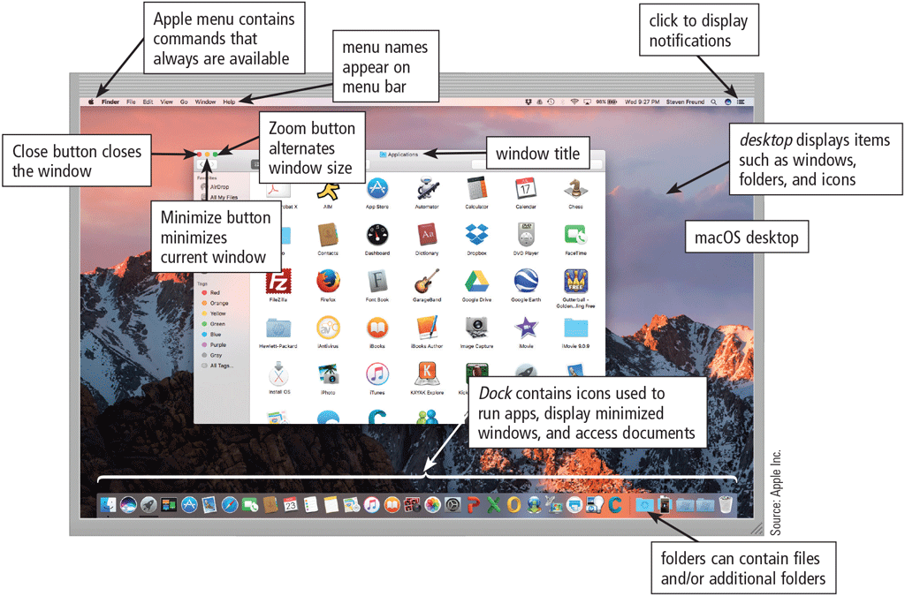
Desktop Operating Systems (5 of 8)
The Macintosh operating system has earned a reputation for its ease of use
macOS

Slide 32
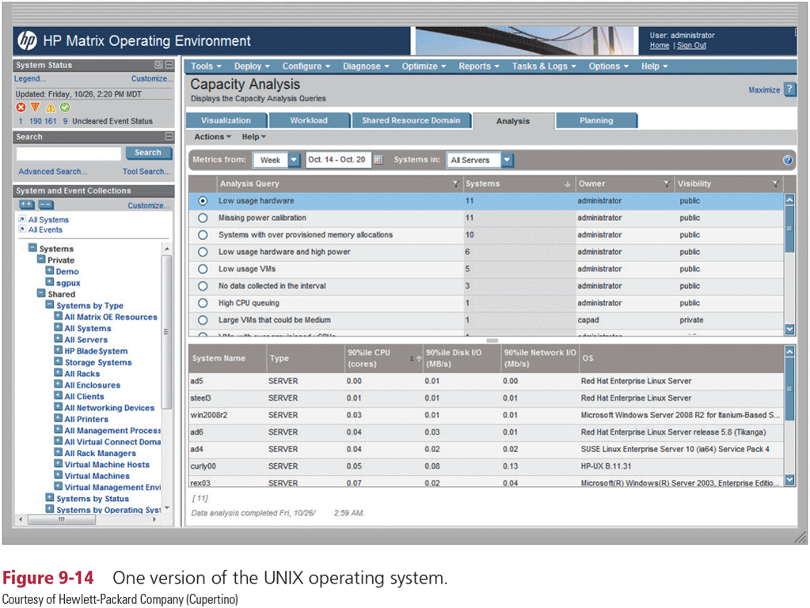
Desktop Operating Systems (6 of 8)
UNIX is a multitasking operating system developed in the early 1970s

Slide 33
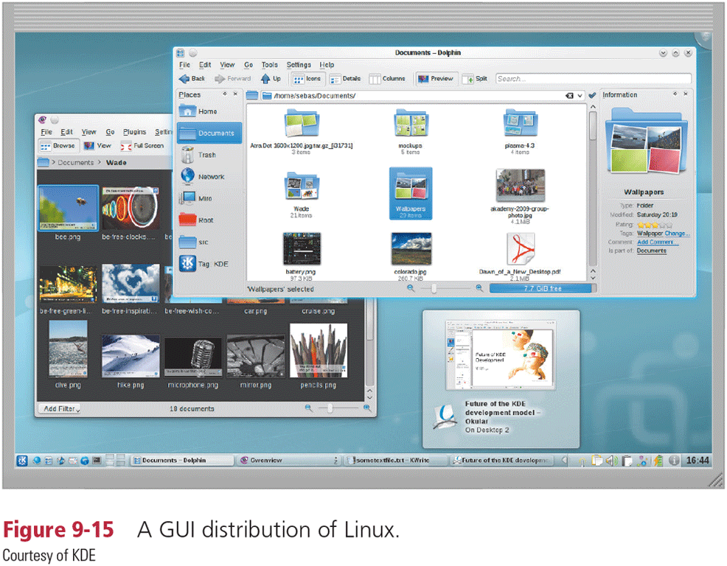
Desktop Operating Systems (7 of 8)
Linux is a popular, multitasking UNIX-based operating system

Slide 34
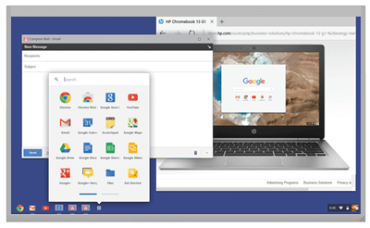
Desktop Operating Systems (8 of 8)
Chrome OS is a Linux-based operating system designed to work primarily with web apps
Figure 9-16 Chrome OS is a Linux-based operating system by Google.

Slide 35
Server Operating Systems
Windows Server
macOS Server
UNIX
Linux

Slide 36
Mobile Operating Systems (slide 1 of 4)
The operating system on mobile devices and many consumer electronics is called a mobile operating system and resides on firmware
Android
iOS
Windows 10 Mobile

Slide 37
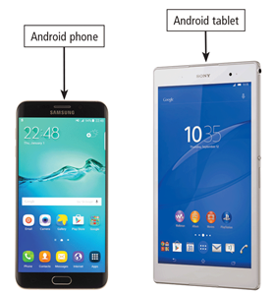
Mobile Operating Systems (2 of 4)
Android is an open source, Linux-based mobile operating system designed by Google for smartphones and tablets
Figure 9-17 An Android phone and tablet.

Slide 38
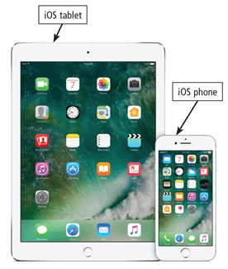
Mobile Operating Systems (3 of 4)
iOS, developed by Apple, is a proprietary mobile operating system specifically made for Apple’s mobile devices
Figure 9-18 An iOS phone and tablet. Courtesy of Apple Inc.

Slide 39
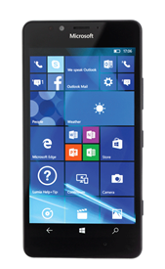
Mobile Operating Systems (4 of 4)
Windows 10 Mobile, developed by Microsoft, is a proprietary mobile operating system that runs on some smartphones
Figure 9-19 Phone running Windows 10 Mobile.

Slide 40
Summary
Functions common to most operating systems
Variety of desktop operating systems, server operating systems, and mobile operating systems

